Slide 1
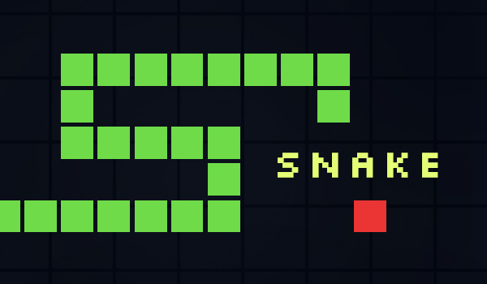
Snake FPGA Game Alberto, Guillermo, Jorge, Larkin

Slide 2
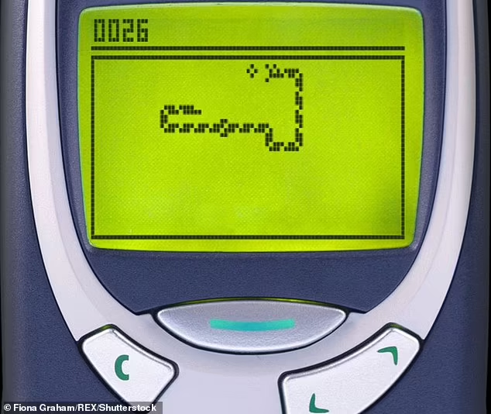
Goal
To recreate the classic video game “Snake” through a functioning FPGA interface (controls) and a VGA display
Uses:
Entertainment
Killing time (Nokia 6110 : 1997)
Benefits to game’s design:
Intuitive
Rapid gameplay
No language barrier or coding experience to play, just load it!
Same game you’ve seen before, familiar!
Notes:
Larkin
Our goal was to design a functional FPGA interface in which we could recreate the classic video game “Snake”.
In real life, this game could be used for entertainment, killing time, or testing motor skills and reflex time. The game can be understood without instructions and is quick enough that it only takes a few seconds to start strategizing approaches to beat the game. This game does not have a language barrier or any coding experience necessary to play.

Slide 3
Functionality
Objective: Implement a snake game with dynamic gameplay rendered on a VGA display
Design Specifications:
Player Control: The snake's direction is controlled using 4 FPGA buttons (up, down, left, right)
Snake Growth: The snake increases in size whenever it consumes an apple
Random Food Generation: Apples appear at random positions, ensuring no overlap with the snake’s body
Collision Detection:
Detects collisions with walls or the snake’s own body
Ends the game when a collision occurs
Display:
Layout: The VGA output renders the game area
Real-Time Updates: Displays the snake’s movement, food positions, and game state dynamically
Verilog Modules:
Input Processing: Captures button inputs and updates the snake's direction
Game Logic: Manages snake movement, growth, scoring, and collision detection
VGA Controller: Generates the graphical output, rendering the snake and apples in real-time
Notes:
JORGE

Slide 4
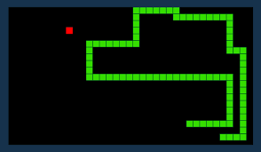
Specification
Design Overview:
The game updates the positions of the snake and apples dynamically It combines gameplay logic and graphical rendering to show the snake, apple, and game status on a VGA display
Requirements:
Verilog modules for input control, game mechanics, and VGA rendering
Randomized food placement logic ensuring it does not overlap with the snake
Collision handling for walls and self-collision, triggering game over
A scoring mechanism that tracks progress and updates dynamically
Clock synchronization to regulate snake movement speed and gameplay timing
Constraints:
Limited FPGA memory for storing snake position
VGA resolution restricts size and visual detail
Minimum delays from input processing and display updates
Collision logic complexity increases with snake length
Notes:
JORGE

Slide 5
Block Diagram (GOAL)
Clock Divider
5 Main Modules
Generates Hsync and Vsync signals
RGB outputs for screen display (snake, apples, background)
VGA Generator
Top Module
Processes movements based on inputs from FPGA board
Updates snake’s position
Adds length to snake
Snake Controller
Apple Position Controller
Generates new (random) positions for apples
Updates Score on display
Handles random repositioning
Game End Checker
Checks for collisions (border and body)
Ends game, displays different screen
Resets all components
Notes:
"HSync" stands for "Horizontal Sync" and "VSync" stands for "Vertical Sync"; these are signals used to synchronize the timing of a video display, ensuring that the monitor accurately displays each pixel line by coordinating the horizontal and vertical scanning process with the data being sent from the graphics card.

Slide 6
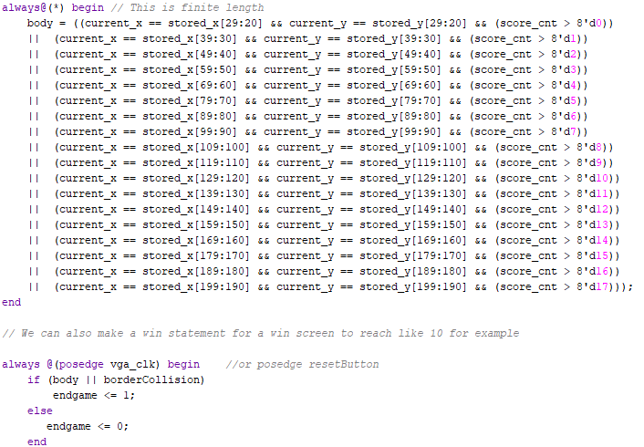
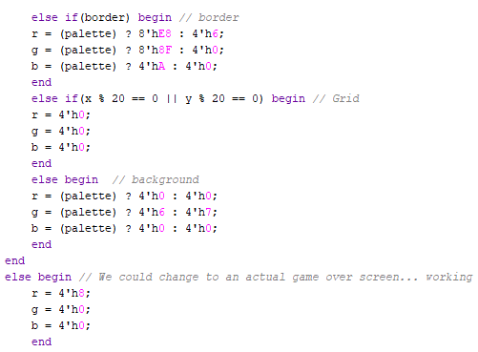
Code
End Game Conditions
Some Displays
Notes:
End Screen
How It Works Together:
Entire code is designed to tell us whether or not the player has done an action that causes them to lose
3 main parts
Wall Collision:
wall_collision is checked on every clock cycle and indicates if a pixel lies within the game border for rendering purposes.
Self-Collision Detection:
As the snake moves, its head position is constantly compared to its body segments stored in body_x and body_y. If the head matches any body segment that is gained as the score counter goes up, it indicates a self-collision.
Game-Over Determination:
The game_over_flag combines the results of the wall collision checks and self-collision checks to decide if the game has ended.
Inputs:
clk
snake_length (8 bits):
Represents the current length of the snake, corresponding to how many body segments the snake has. Each segment occupies a part of the body_x and body_y arrays.
head_x and head_y (10 bits each):
The coordinates of the snake’s head in the game grid. These values track the snake’s position in the game.
body_x and body_y (200 bits each):
These store the X and Y coordinates of all the snake's body segments, divided into 10-bit sections for each segment.
5. pixel_x and pixel_y (10 bits each):
The current X and Y positions of a pixel being processed,
Outputs:
game_over_flag:
A flag that becomes 1 (true) if the game is over, indicating a collision event (with the wall or the snake's body).
wall_collision:
A signal that becomes 1 if the snake’s head collides with the border of the game screen.
Internal Logic:
wall_collision <= (pixel_x < 10 || (pixel_x > 630 && pixel_x < 640) ||
pixel_y < 10 || (pixel_y > 470 && pixel_y < 480));
This checks if the current pixel (used for VGA rendering) lies within the border of the game grid.
We are going to change the borders, but for now borders are defined as:
The left wall: pixel_x < 10
The right wall: (pixel_x > 630 && pixel_x < 640)
The top wall: pixel_y < 10
The bottom wall: (pixel_y > 470 && pixel_y < 480)
self_collision Logic: verilog Copy code self_collision = ((head_x == body_x[29:20] && head_y == body_y[29:20] && (snake_length > 8'd0)) ||
(head_x == body_x[39:30] && head_y == body_y[39:30] && (snake_length > 8'd1)) ||
...
(head_x == body_x[199:190] && head_y == body_y[199:190] && (snake_length > 8'd17)));
This block checks if the snake’s head has collided with any of its body segments.
Each condition compares the head’s X and Y coordinates (head_x and head_y) to the coordinates of a body segment (body_x[...] and body_y[...]).
The snake_length ensures the logic only checks valid body segments (for example, if the snake has 5 segments, it won’t compare with segments 6-18).
game_over_flag Logic: verilog Copy code if (self_collision || head_x > 640 || head_x < 0 || head_y > 480 || head_y < 0)
game_over_flag <= 1;
else
game_over_flag <= 0;
This block determines the game-over condition:
If the snake’s head collides with the game border (head_x > 640, head_x < 0, etc.).
If the snake’s head collides with its body (self_collision).
If any of these conditions are true, the game_over_flag is set to 1, signaling the end of the game.

Slide 7
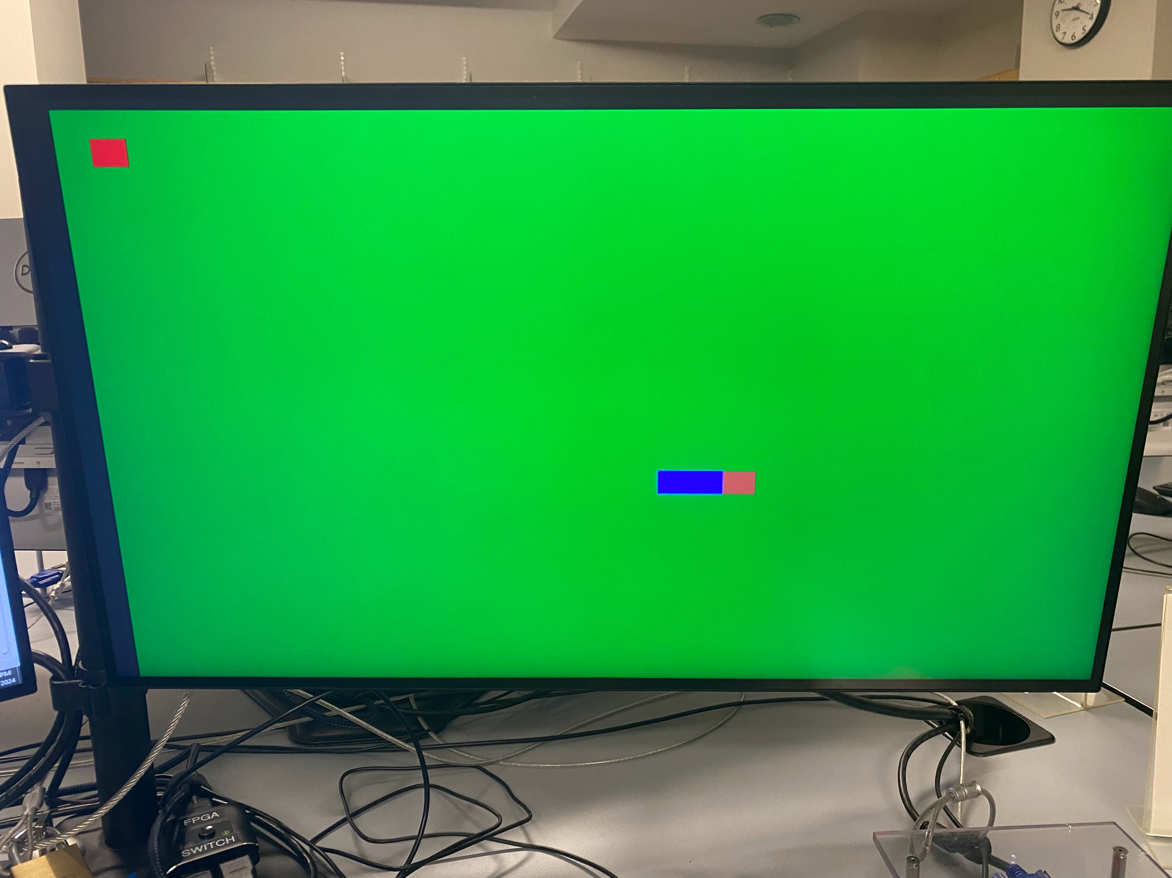
Successes
Generate background, snake, and apple
Generate temporary game over screen
Different colors for each item indicate the differences in how the snake interracts
Head - brown: the movable game piece
Tail - blue: snake body + game over condition
Apple - red: snake will grow
Background - green: neutral. No interaction
Using the reset switch, snake moves to the right, and position updates with each clock cycle
Insert photo of our game here
Notes:
Larkin

Slide 8

Failures
One direction so far…
Won’t be possible to play the game to its full extent
Only able to test snake growth with apple positioned directly in front of snake
Small screen offset
Snake can technically move outside the screen
Confusion and inability to properly view the entire playing surface
Apples might not be visible
Next Steps:
Understand what exactly went wrong!
Adjust code’s parameters and variables
Check directional conditions
Insert photo of our game here

Slide 9
Thank you!

